Slide 2
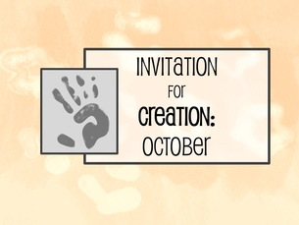
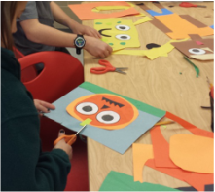
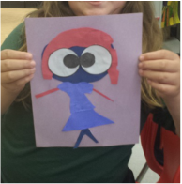
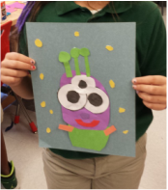
Invitation for Creation: October
10/21/2015
0 Comments
The lessons I teach in K-5 Art are typically highly structured, meaning they are usually teacher-led. But while planning lessons during a busy week before a seasonal break, I first saw an opportunity to come up with a more student-led project.
I call this an "Invitation for Creation". Basically, students are provided with a challenge to incorporate a given piece or media into their artwork.
​For a 2D piece, the students are given...
​1. The challenge piece or media 2. A blank sheet 3. Guidelines for use of acceptable materials
​A Challenge Piece
Can be anything extra you have on hand. If you don't have an abundance of material, you can always draw one and copy it to make enough for a large class or grade level. ​
A Blank Sheet
I like to use a thicker piece of paper, such as sulfite or construction paper. Sometimes, I'll have them use tag board/cardstock. Another idea is to have the students pick the size or color.
Guidelines
Here is where I define which material will be set out for students to incorporate into their artwork. I like to use up my scrap construction paper pieces this way, and I'll put some out on the table along with glue. Other times, I'll have them use just crayons- like at the end of the year when supplies are being stored away for the summer. I do demonstrate some possibilities as far as technique.
Invitation for Creation: October
This simple challenge was perfect for October. You have students who may want to celebrate the scary, and others who may not celebrate Halloween, but they are still able to participate in your challenge, since you are not necessarily defining the subject of the artwork- they are. ​
Challenge Piece: Googly Eyes
Here are the quick googly eyes I made. You can use the googly eye pieces if you have enough, but I didn't at the time, so I made due! ​
Blank Sheet: Construction Paper
I let students decide which color would best suit their idea, and made each color available to them as they chose their base. ​
Guidelines:
Gluestick, Scissors, Construction Paper scraps only. I told them they may use whatever is available to them on their tables and that I was checking to see how well they would share with others. I also told them that I am looking at their craftsmanship skills.
Early Finishers
​If a student finished early, I would have them write a story about their creation. I had some comic relief when reading them! And their teachers loved that I provided a built in prompt by having them create their story based on their artwork! Also, if time allowed, I had the students tell me what is happening in their artwork, as they shared with the class.
​Some Results
I hope you are as amused with the results as I was, and as always, feel free to share pics or modifications in the comments below! ​ ​ -Stephanie

Slide 3
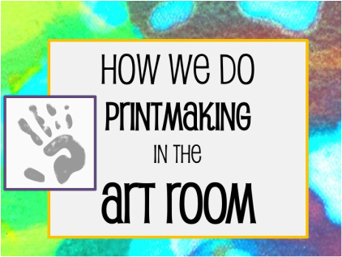
 | ​Printmaking in the Art Room sounds really messy and also sounds like a lot of work. Which is exactly why I had avoided doing it as a class activity for years...
But, last year, I decided just to GO FOR IT! This is what I've figured out works for me, and hopefully you'll be able to imitate some of this for your classroom, too! Believe me, no matter how the prints turn out, the students are always impressed with the results!
1. INK
At the bottom left of the photo, you can see the inking plate I use. It's just a scrap piece of laminate counter, cut to square size. Perfectly smooth and sticky for loading ink onto a brayer. Underneath is a piece of recycled signage/foamboard that I don't mind getting destroyed.
2. PRESS
As the student comes up, they place their printing paper over the clean brayer. Their paper is labeled with their name on the back and the series on the bottom right. After the plate is fully inked, the student turns the paper over onto it, then rolls on the back with the clean brayer.
3. PULL
After I give it a strong once over to make sure all edges are pressed, I have the student pull the print very carefully and place it on my carpet to dry. Next, they come back to the station and use baby wipes to wipe their plate clean and also clean their fingers. There's a garbage can right under my printmaking station. Voila! All this used to intimidate me, but now I think printmaking's a breeze!
Cheers to print pulling! ​-Stephanie

Slide 4
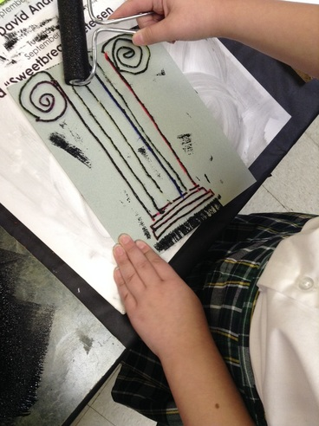
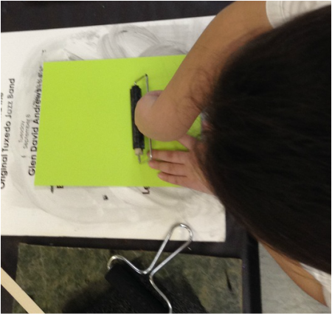

Slide 5
Journey to Journaling: Part I
9/30/2015
0 Comments
I've always liked the idea of mixing Literacy and the Arts. After all, Art is the universal language through which to communicate. ​Literacy and the English language is just a subset of communication because we are limited to 26 letters to express ourselves. In contrast, communication using Art is only limited by the possibilities of one's imagination...
So, through our blending of Art and Literacy, we are actually equipping our students to communicate more effectively. ​
Why I Feel My Students Should Journal in Art
​​Literacy is merely one subset of communication. We are limited to 26 letters to express ourselves. In contrast, communication using the language of Art is only limited by the possibilities of one's imagination.
Starting Out with the Basics- Materials
This year's class is experimenting with Altered Books. And by Altered Books I mean, I went to the Dollar Tree and filled an entire cart of hardcover novels from the shelf (sorry, authors!) for my students to destroy/create.
​I (not-so-secretly) HATE the idea of destroying texts...
​but, if they are going to be used for creation, then I guess I am OK with it! Just know that I first learned about Altered Books in 2007, and this is 2015, so you can tell that I took a very long time to warm up to the idea! :)
Setting Up Our "Canvas"
​The first thing I had them do was rip out about half the pages from dollar store hardcover novels. This will allow us room to grow as we layer, glue and collage pieces onto the pages throughout the year.
The kids LOVED this step. I worked on ripping some of my pages out, too. And let me tell you, it surely was a stress-reliever!
Cover and Spine Design
I have to add more pics later, but for now, here's one example of the cover. The student painted the hardcover with glossy tempera, and then went over it with pieces of duct tape, attaching a personal piece of ephemera on the cover. The white sheet you see is parchment paper, so the damp painted or glued pages inside don't stick to each other.
Table of Contents
Using the Table of Contents, each student tells me which page they created the daily assignment, so I can check to make sure each assignment is complete.
First Pages
The first task assignments were simple things, like
Create a Color Wheel
Design a Value Scale
This way, as the attacked the pages, I could get a better idea of how each child handles the artistic prompt and assess what basics they know, and where I need to fill in the gaps.
Rubrics
If you've been following me for a while, you know that I'm a huge fan of rubrics. I explain and remind the students of the expectations of a completed page, constantly referring back to the rubric.
Class Journaling Contracts
The students and their parents signed a Journaling Contract, agreeing that if they missed class demos, page assignments, or otherwise didn't complete the work, that they would be assigned written makeup work.
Teacher Reflections
As the first marking period comes to a close, here are some things I observed as I assigned page tasks:
At first, students who journal seek teacher approval, rather than enjoy the opportunity for creative expression.
Some students sit there 'uninspired'- usually my
It takes a long time for a student to develop intention, rather than just place pieces on a page.
Time management skills for Art must be taught in order for each student to reach his or her productivity potential.
Students have a hard time interpreting "vague" directions in Art. They ask me, "Is this OK?" "Did I do this right?"
In another post, I'll discuss these observations and my style to remedy them. Happy Teaching! ​-Stephanie

Slide 6
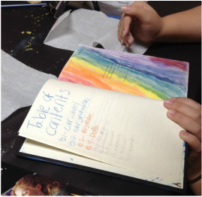
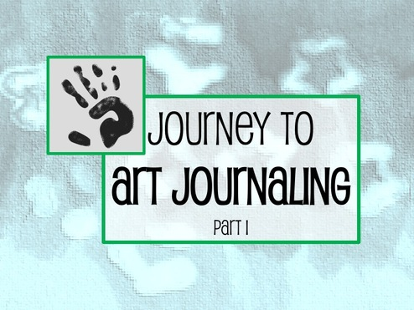
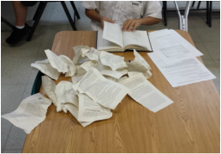
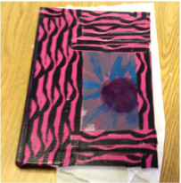

Slide 7
Quick Fix: A Sink Shortcut for the Art Room
9/15/2015
0 Comments
My Solution For Eliminating the Line at the Sink After Painting
I have a problem. A very common Art Teacher problem.
My sink is oh so VERY small!
After a particularly busy clean-up day working with watercolor during my Art Appreciation class, I revisited my paintbrush cleaning policy.
I needed a better way.
This is why I'm a fan of routines and procedures: I want to maximize class time with my students so they can spend more time creating art, and less time cleaning up and doing 'housekeeping'.
But, the line at the sink was TOO long!
so, I decided to make my "sink line" more efficient.... By eliminating it!
Here's how I did that:
1. I placed a mop bucket (with a spout) and two deli containers on a table (or a desk). You may choose to cover desk with tablecloth or art roll paper, like I did. 2. I wrote reminder phrases on Post-its: "Dump dirty water here" "Place dirty brushes here" "Put empty water cups here" "Set opened palettes flat to dry" (Eventually, I'm sure I'll make some fancy-nancy laminated signs, but for now I'm a fan of "posties") 3. When students have dismissed: I quickly dump out the dirty water bucket, sometimes I spray with Lysol or rinse with soapy water. Then I add brush-friendly soap + water to the deli containers, fill them with water and rinse the contents. Then, I lay brushes flat to dry on a towel. I put the water cups (I use condiment cups from the dollar store, or old minute rice cups) on a plastic dish-rack or sometimes just stagger stack them upside down to dry.
My quick fix for eliminating the sink line.
This may take more time for me...
but, if it lets the kids have more time to work on their art, then I'm willing to sacrifice 3-5 minutes of my lunch. Besides, it shaves about 8 minutes off my cleanup. I now give them a 2 minute clean-up- it's a routine/assembly line/mindless/habitual clean-up. *Note* I usually do a chant to remind them:
"Brush side UP... in the CUP!"
...but in this case, these brushes are only in the deli container for such a short time, that I really don't care if they do put it up or down.

Slide 8
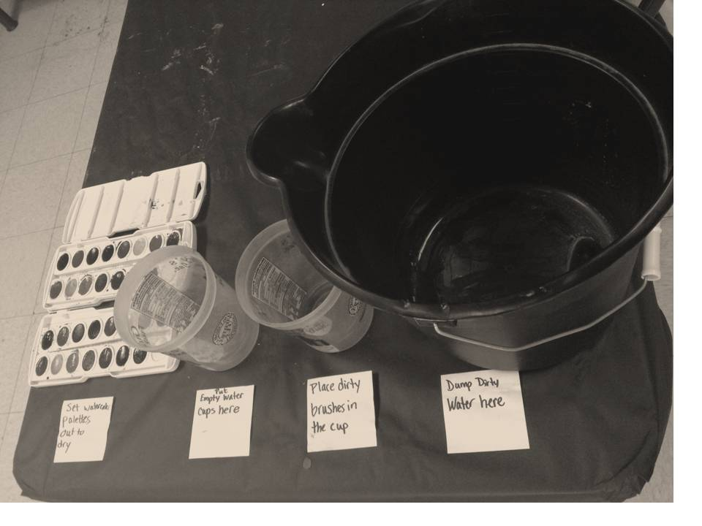

Slide 9
My Very First Live #K12artchat on Twitter
9/8/2015
0 Comments
Last week, I participated in my first #K12artchat on Twitter. I first heard about this whole thing at the National Art Education Convention '15 in the spring here in New Orleans when I popped in to see some awesome presenters who were well versed in technology, social media and networking. I was impressed at the way they blended all three skills to increase their art teaching expertise and that of others. Fast forward to the fall, when last week, I figured with it being a new school year and all, I'd better participate or I'd be missing out on some awesome stuff!
What's a PLN?
A PLN includes the colleagues, professionals, etc that you discuss work with, outside of work. PLN stands for Personal Learning Network.
How Does #K12artchat Work?
Every Thursday, a designated host poses some interesting questions, typically along a theme that's relevant to Art Ed. Last week's was "Creativity", hosted by Tim Needles:
Each weekly chat has questions on a certain topic that people answer, according to their experience in the classroom. Additionally, resources and links are shared and frequently more questions on the topic are raised.
So That Seems Easy...
But, there's a catch... Remember that when you answer questions, you only have 140 characters available to craft your response! For me, this is incredibly difficult! As you can see, I love to write, and I tend to be fairly wordy in my writing. So, any answer I come up with forces me to be concise.
Sometimes you may have to abbreviate...
Obviously, I went a little overboard on the abbreviations on this post up there, but FYI: Ss=Students Ts=Teachers
So, you wanna try it out?
Here's the basics on how to participate in a #K12artchat on Twitter on Thursday evenings...
The "community" is incredibly welcoming, and you have nothing to fear, because they'll help you along, as they did for me! Hope to see you there on Thursday...Happy Tweeting! -Stephanie

Slide 10
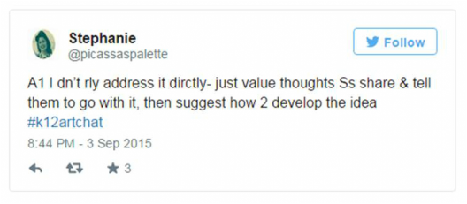
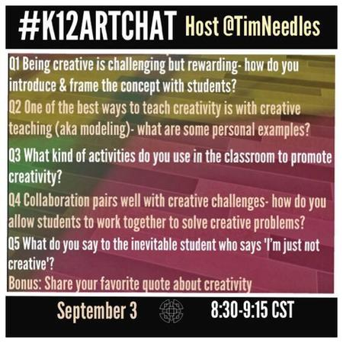
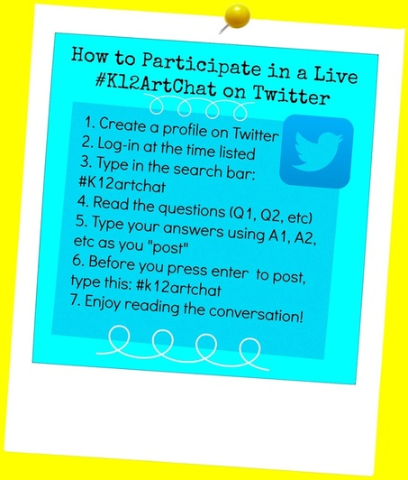
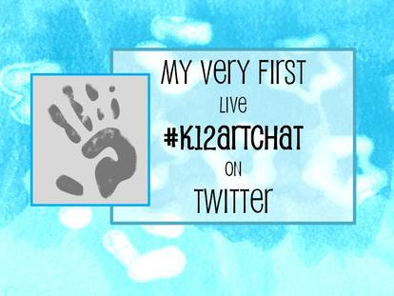

Slide 11
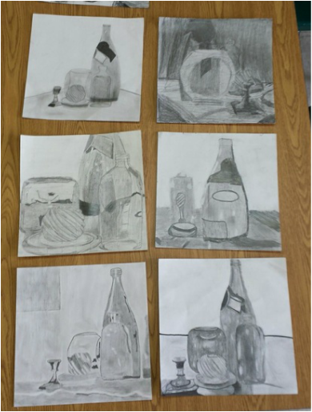
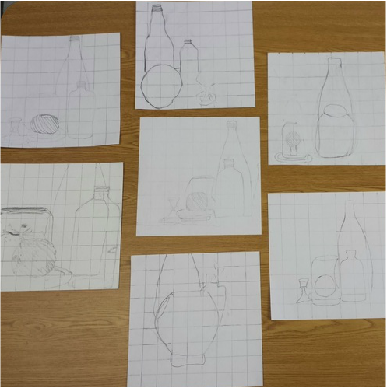
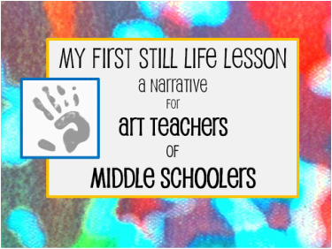

Slide 12
Beginning Realism: First Scaled Still Life Project﻿
9/2/2015
1 Comment
First, I arranged a still life including glass bottles, jars and a candlestick holder over draped fabric. I shone the light of my retro overhead projector onto the still life so the contrast was more dramatic. This made it easier for them to notice the darkest darks and lightest lights. Next, I invited the students to take a photograph on the classroom ipad from any angle. They were also allowed to rearrange the objects to their liking. Most left them the way they were. To accommodate for time, I cropped the photos to a square shape, printed the photos in black and white and drew the grid directly onto the photo. For this step, I had to make sure the total area of the grid matched the total area of the paper, so yeah, a little math was involved... but I love to keep that side of my brain working! To begin our scaled transfer, we used the grid method to divide our square-shaped paper into 1x1 inch squares. Even the ruler use proved to be a challenge for some, but with assistance and a lot of discouraged sighs (from them, not me- promise!), they pushed through and accomplished this tedious task. Then, I had to emphasize that the students drew each square exactly as it appeared in the photo. My students were used to the "eyeball" method, so many were instinctively just transferring the perceived shape without regard to scale. The best way I found to approach this was just to point out the differences between the box on the photo and the matching square on the grid. More frustrated sighs...learning new methods can be uncomfortable, but that's a good thing, because we are stretching our minds!
So here you can see that the grid transfers ranged from primitive outlines to more expressive line drawing techniques. Some "got" it right away and started to blend their "eyeball" drawing instincts with their new skill of accuracy through grid transfer. Now was a good time to mention to the students that realism takes TONS of hours, days, weeks, years of practice. Realism isn't what every single artist does, that each has their own preferred technique of expression, and that it didn't make them less 'artistic' if they didn't take to this method with ease the very first time. Next, we started to examine the values within the b&w photo. I recommended to the students that they find the darkest darks in their photos and work to progress to the lightest areas using gradation or abrupt contrast. Some chose to use tortillons or flexible erasers to blend the graphite. Others found they weren't able to achieve the darkness of some areas, so I gave them the opportunity to use a charcoal stick once they had a varying range of values. This is where it became so amazing to me to see the difference in artistic styles, even at the middle school age. I had to challenge my heavy handed students to add areas of highlights, and my light handed students to incorporate shadows.
I'd say, "not bad!" for their very first still life project! They were very proud of what they accomplished once they finished their drawings. During closure, I reminded them of their lack of comfort during the challenging parts, and told them that their minds have to get a little uncomfortable to be able to change and adapt to learning new things, not just with drawing, but also in life :)
 | Through a unit focusing on abstract vs realistic art, I decided to provide the experience for my middle school students to try a still life for the very first time. And WOW was I impressed!

